Slide 1

INTRODUCTION
Golden Dove Events! wedding planners have built special relationships with tried and trusted wedding professionals since 1990, opening up exclusive options & discounts on everything from the venue to entertainment choices.
Our experienced wedding planner team will take you through our briefing to find your ideal wedding date, theme and ideas, and most importantly budget.
with your agreement, we will then do the legwork by detailing with
contracts, vendors, schedules, and planning, to delivers your perfect wedding day on time and stress-free.
Our professional wedding planning services covers details, including
those you may not even have thought of:
Cost & Budget Planning
Selection of Hotel / Venue and Coordination.
Vendor Booking and contracting.
Ensure Guest / Group Welcome at Hotel/Venue.
Preparation of the events list with details for the bride & groom
side in the prescribed format.
Messages to the guests on WhatsApp group / App for
events/meals/venues.
Arrangement of walky-talky. (As per actual charges)
Placement of Welcome Basket/Hamper for the room. (As per actual charges) Controlling Arrival & Departures.
Transportation Coordination & Logistic management.
Arrangement of munchies & water in coach & cabs. (As per actual charges)

Slide 2
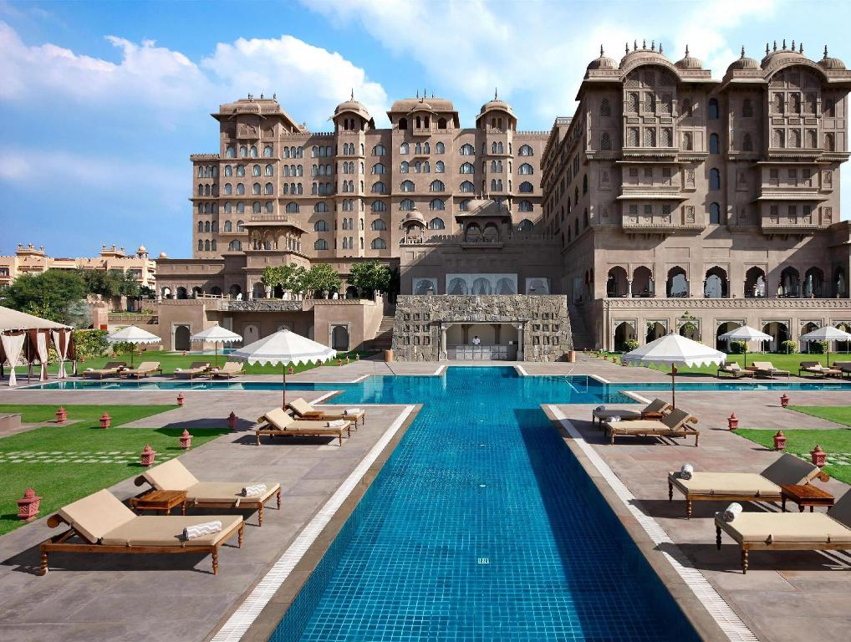
VENUE = FAIRMONT
DATE = 25TH NOV – 27TH NOV

Slide 3
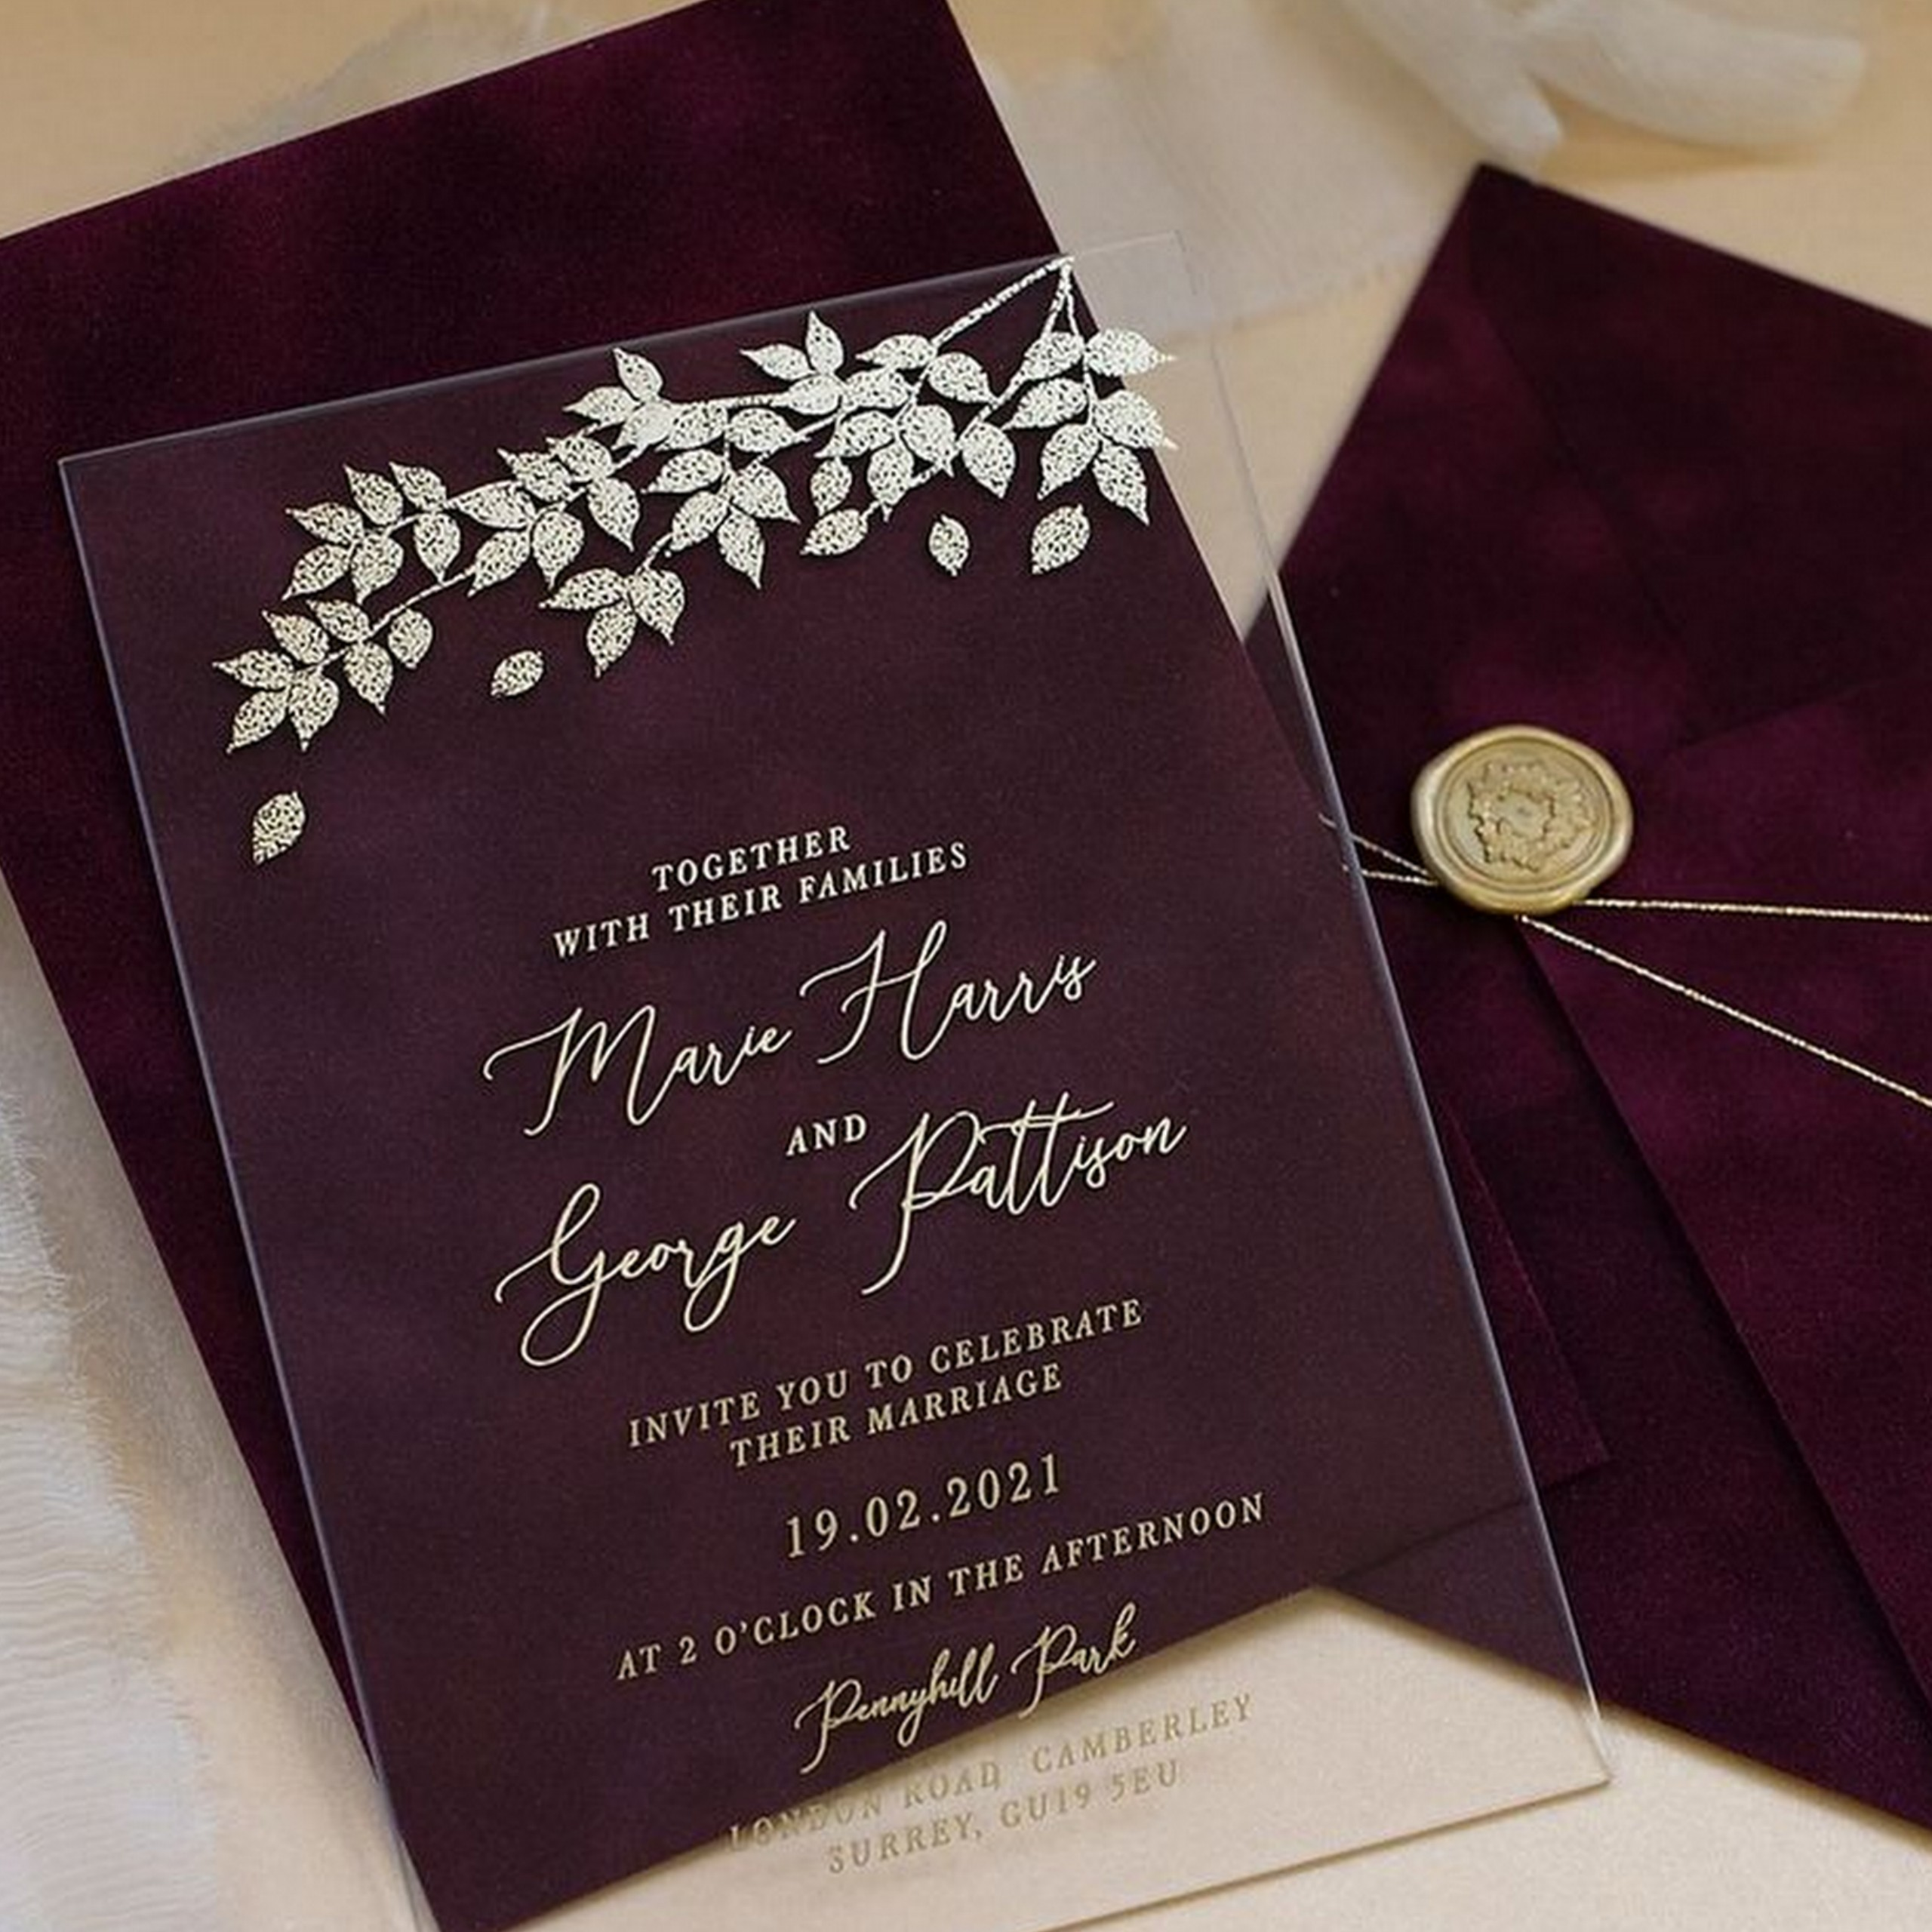

OUR SERVICES
INVITATIONS
INVITATION CARDS
ONLINE INVITATION TEMPLATES

Slide 4

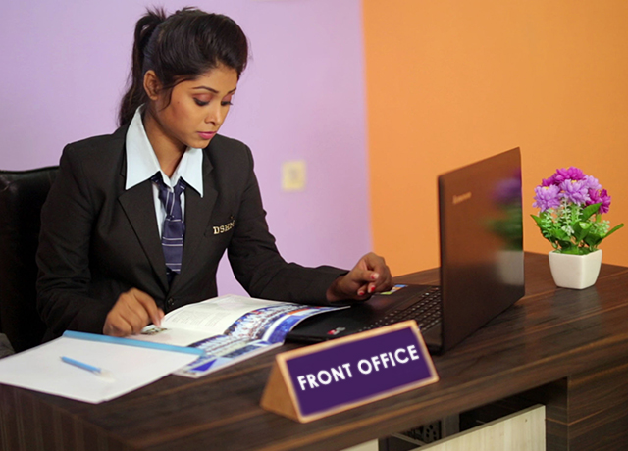
RSVP(calling to guest)
We give a Call to our guests to Invite them and ask there details.
For Example:-
Arrival Date
Arrival Time
3) Addhar card ( front n back both side
Also, May we please request you to send us all the Id's of members coming along with you in one pdf form instead of sending them separately.

Slide 5
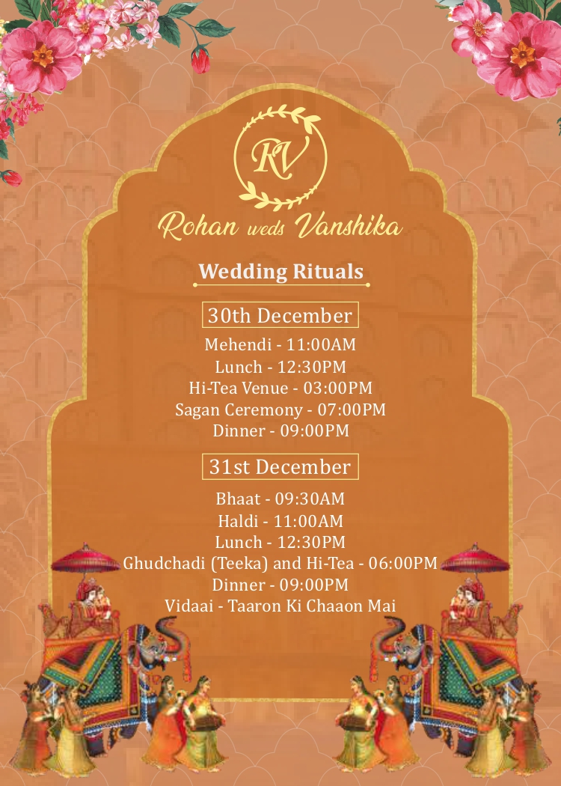

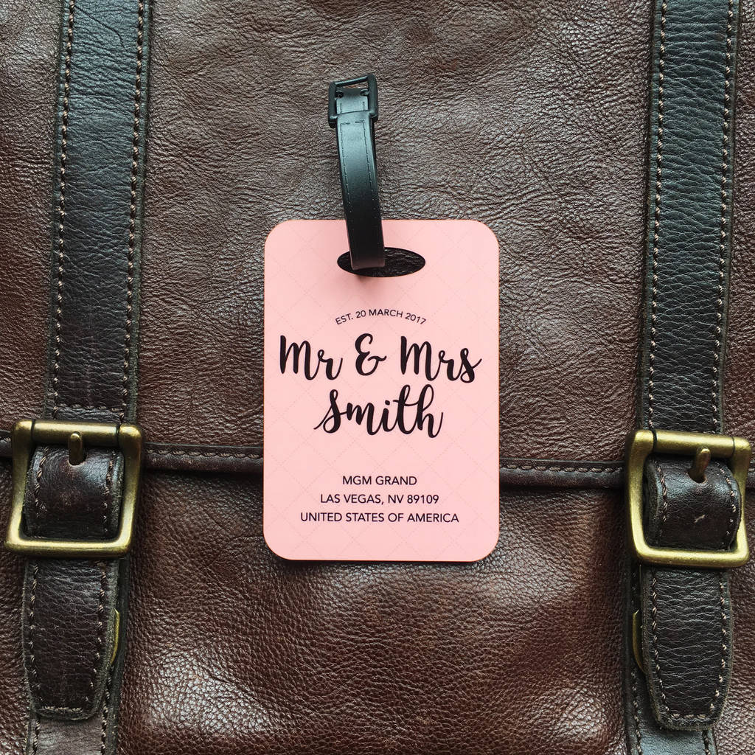


STATIONARIES
ITENERY
KEY COVERS
LUGGAGE TAGS
THANK YOU CARD
WELCOME CARDS

Slide 6
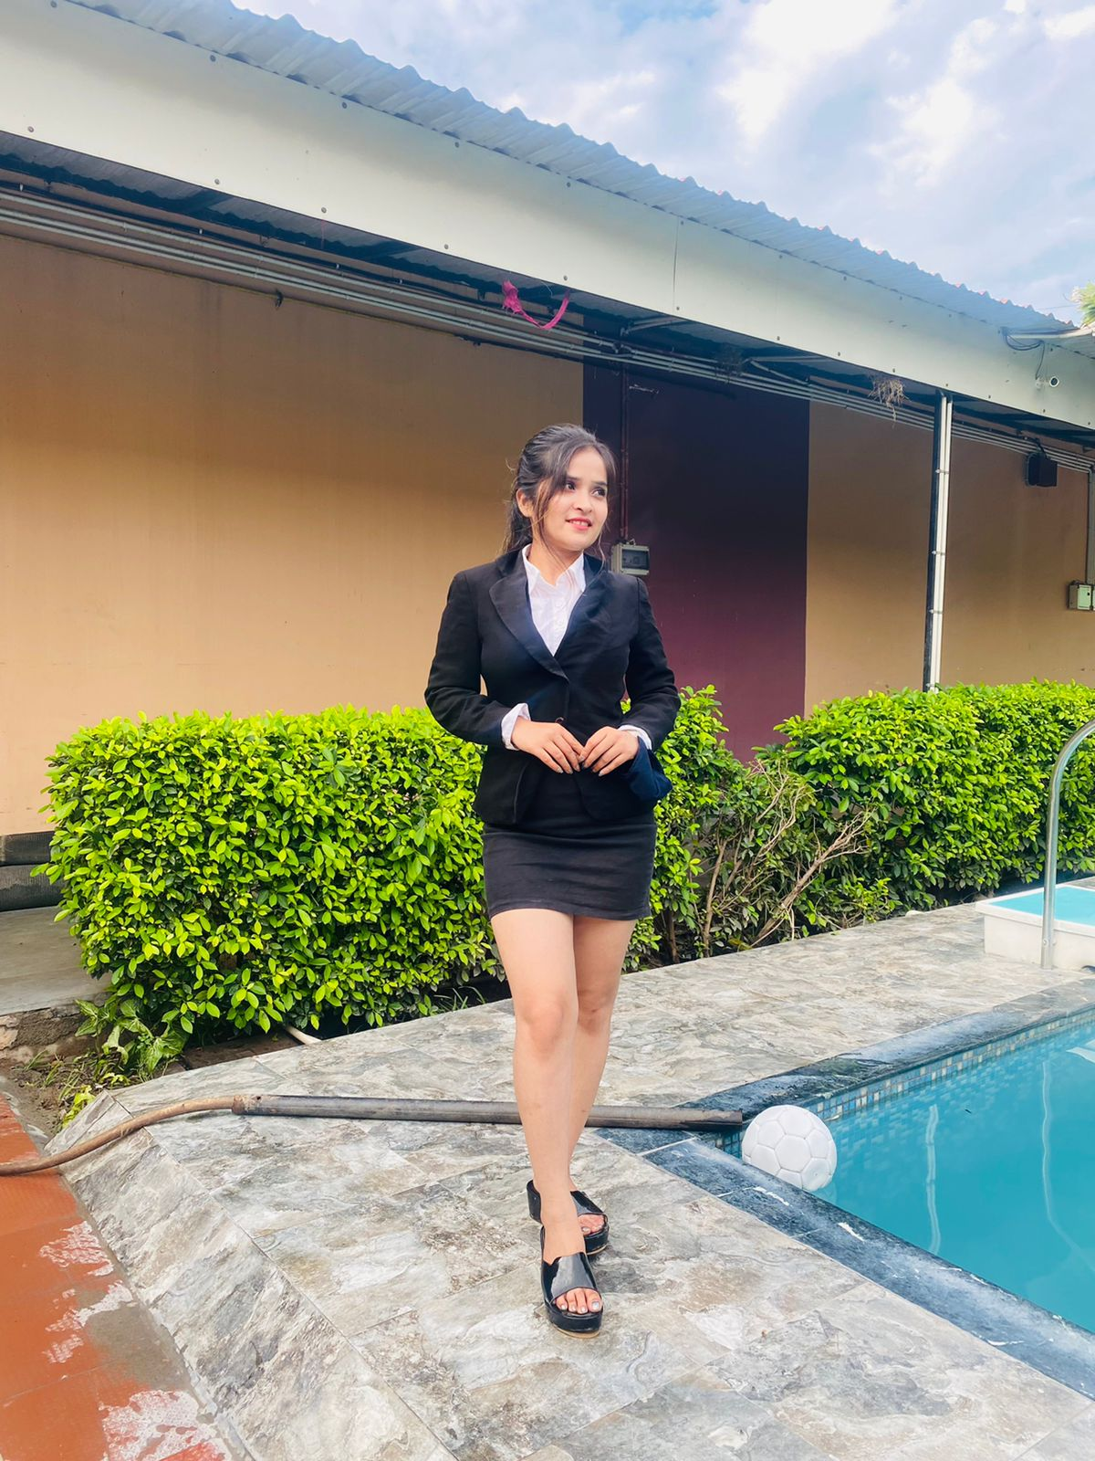
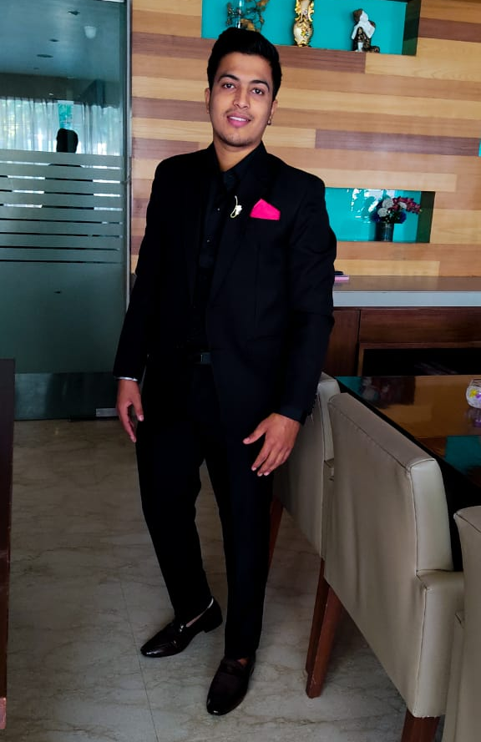
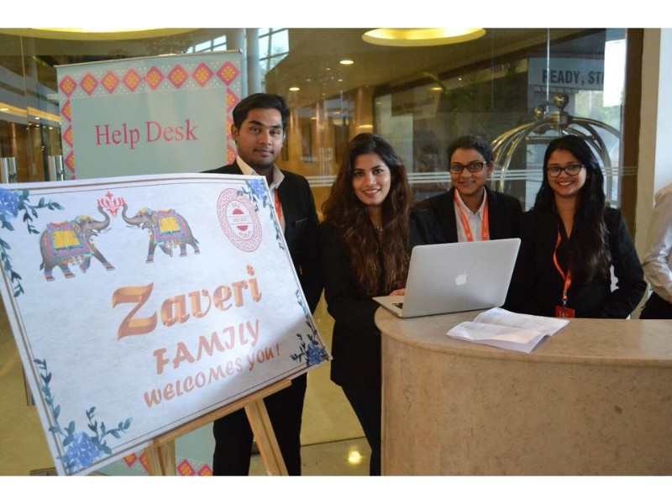
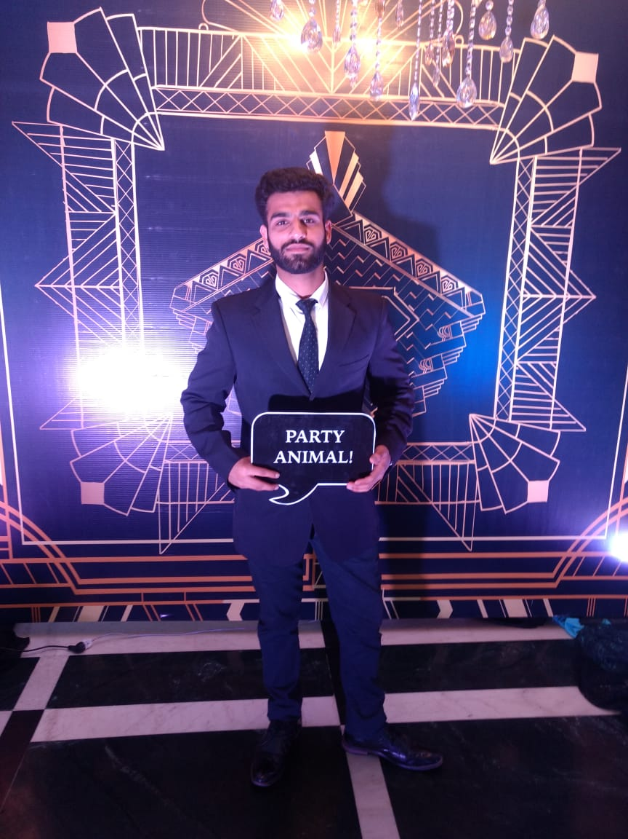
HOSPITALITY TEAM
FEMALE SHADOW
MALE SHADOW
CHECK-IN TEAM
RUNNERS

Slide 7
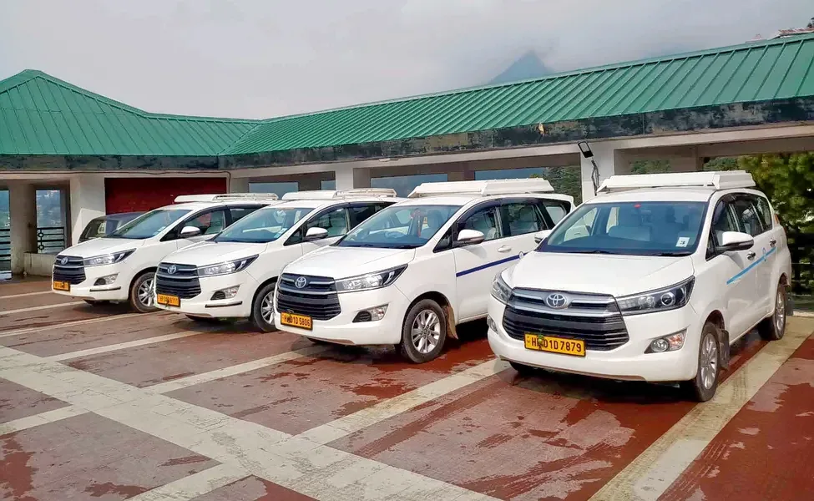
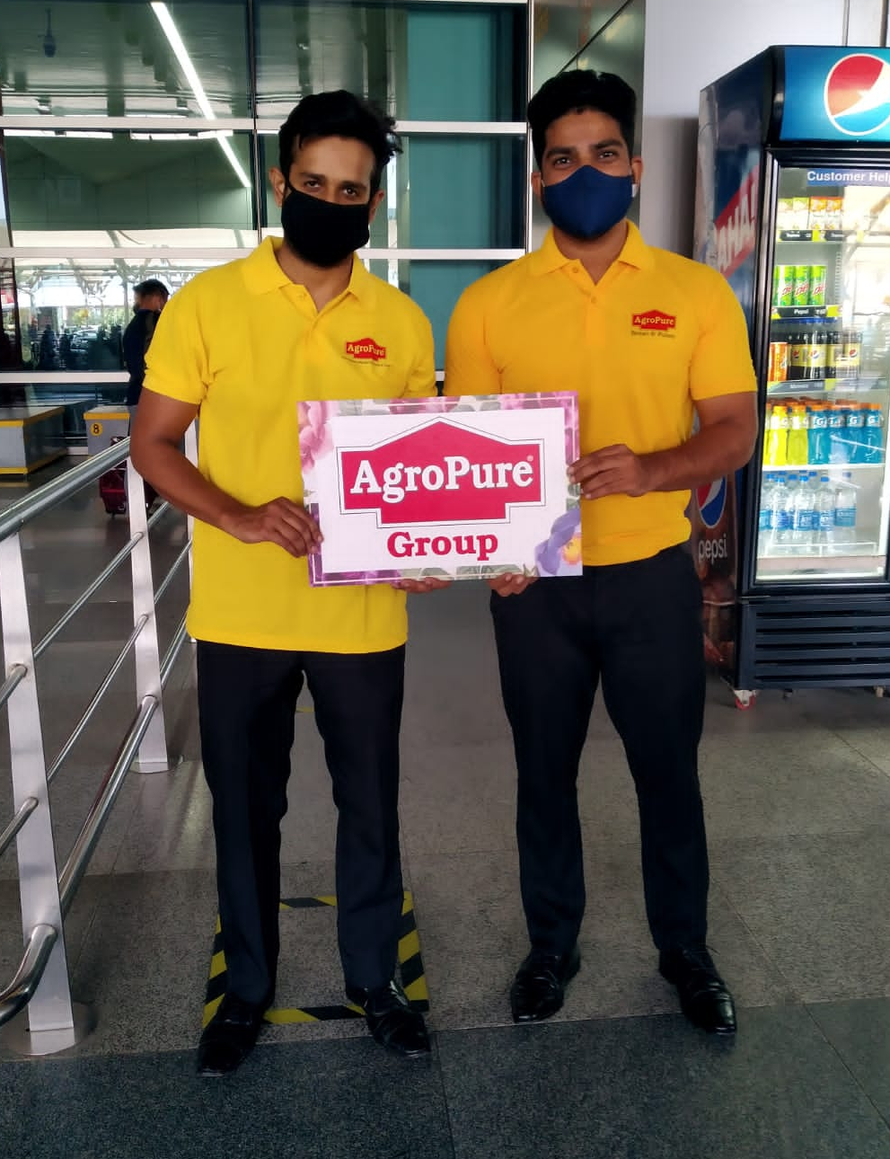
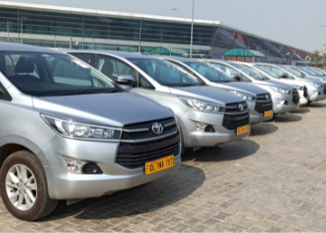
Logistics/transportation
Making arrangements for transportation to pick up guests from the airport, railway station or bus stop and dropping them at the hotel or wedding venue is an important part of planning a wedding.

Slide 8
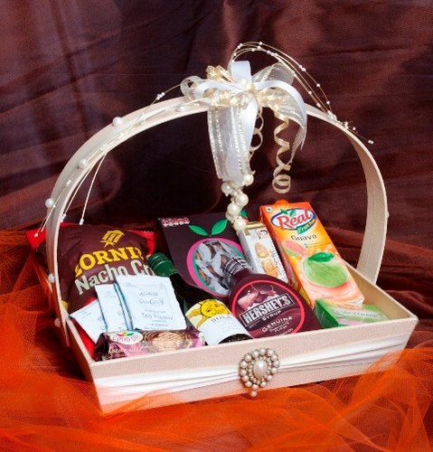
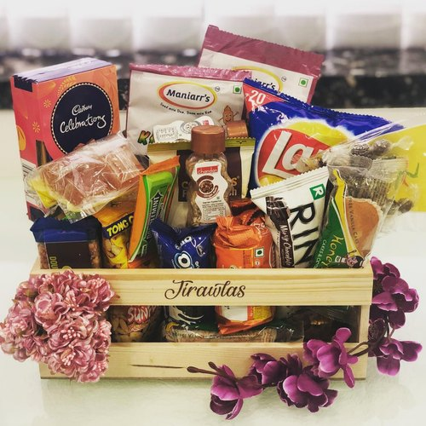
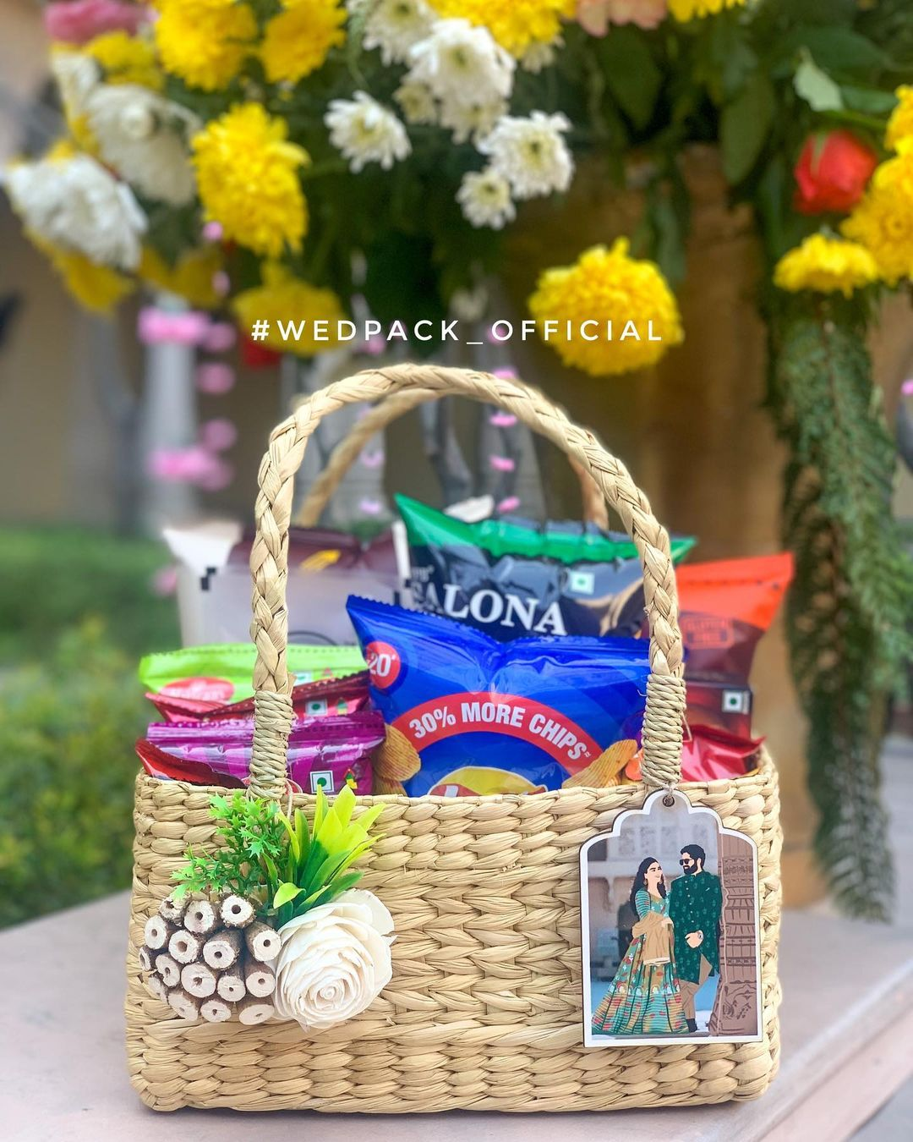
Room Hampers

Slide 9
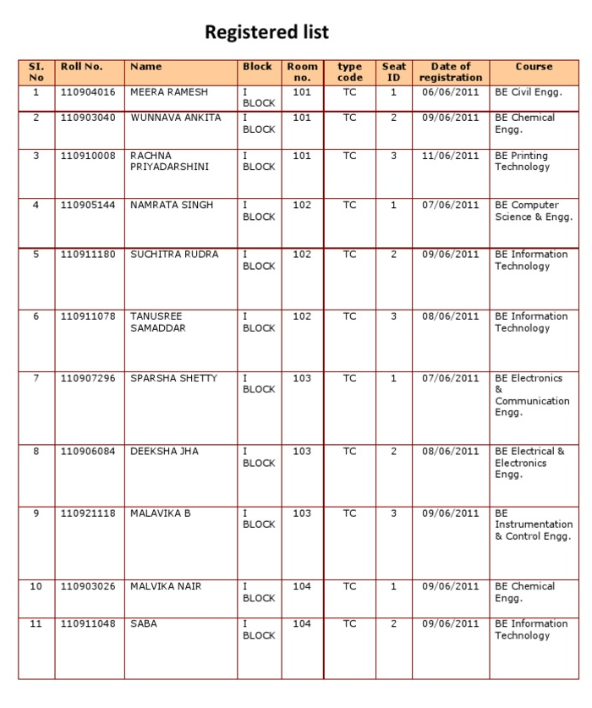
ROOM ALLOTMENT

Slide 10
SHOW FLOW

Slide 11
25TH NOV 2022
CHECK-INS
MORNING - MEHNDI FUNCTION (CARNIVAL THEME)
EVENING – SANGEET
26TH NOV 2022
BREAKFAST
MORNING – HALDI FUNCTION
AFTERNOON – SAJANKOT
EVENING – BARAT, BARAT SWAGAT, PHERE (7 PM – 9 PM)

Slide 12
GUESTS ARRIVAL

Slide 13
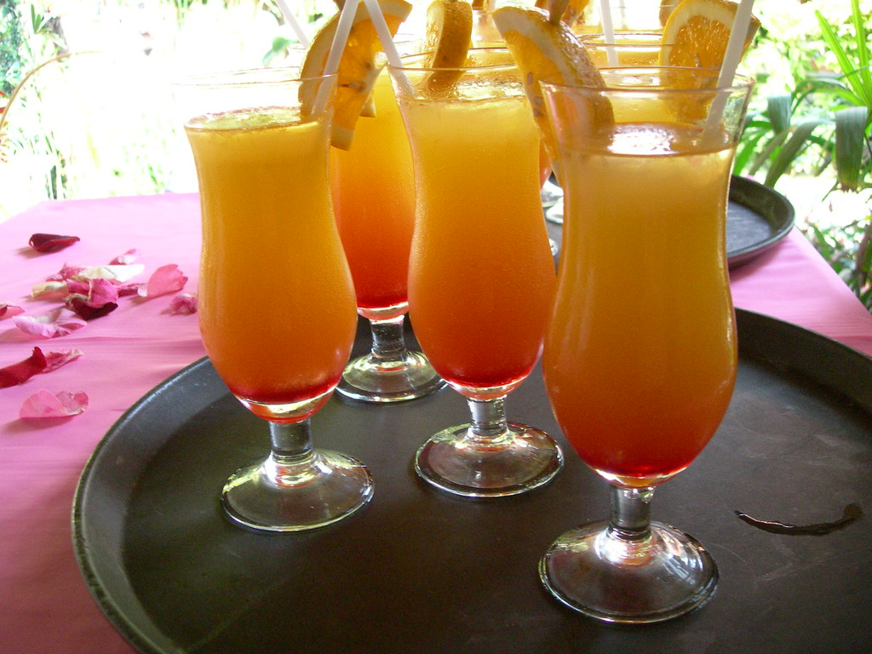
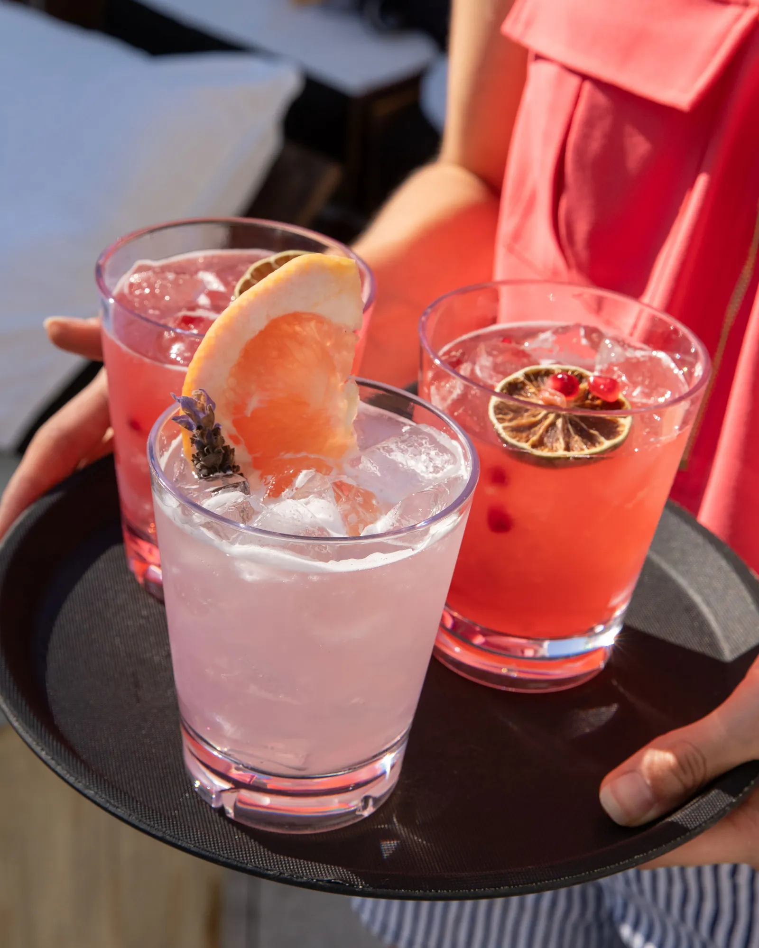

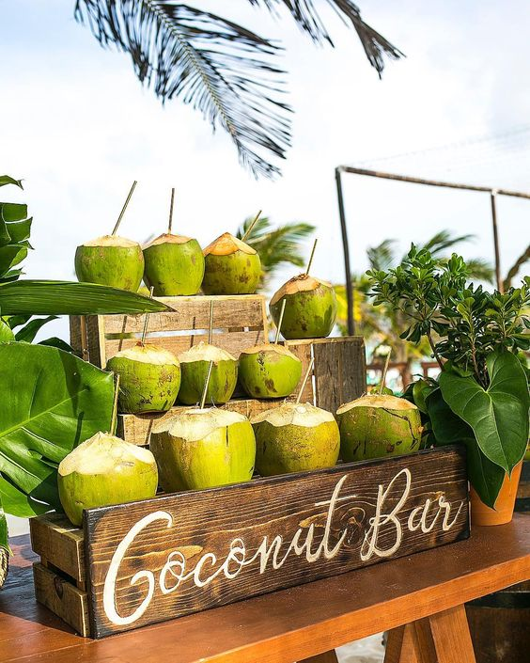
GUESTS WELCOME
WELCOME DRINKS
ORANGE JUICE
LEMONADE
LEECHI JIUCE
COCONUT WATER

Slide 14
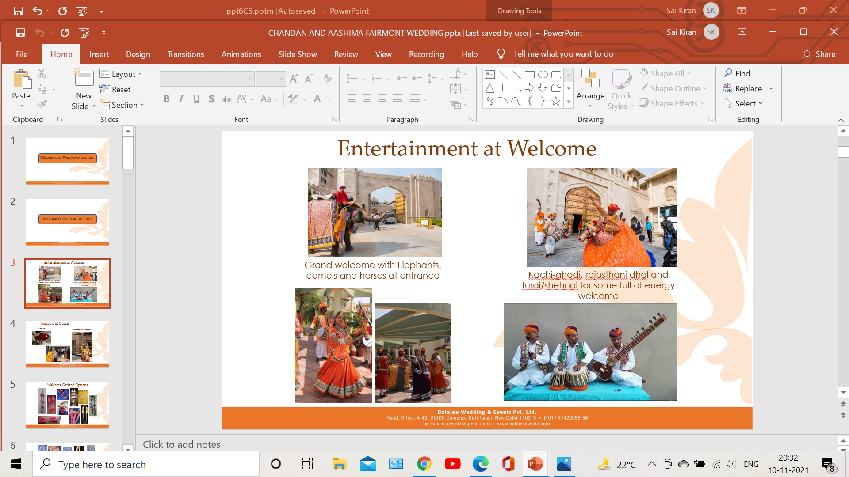
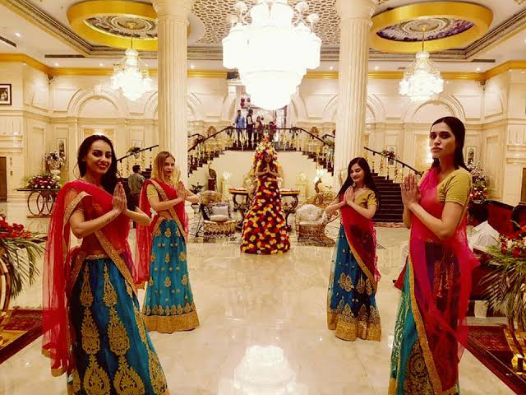
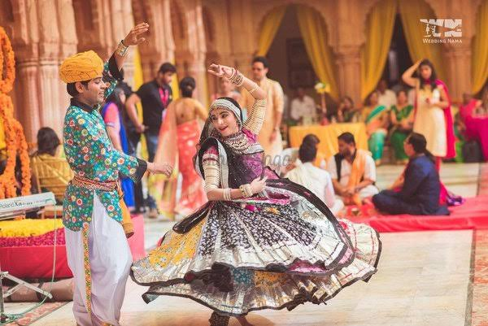
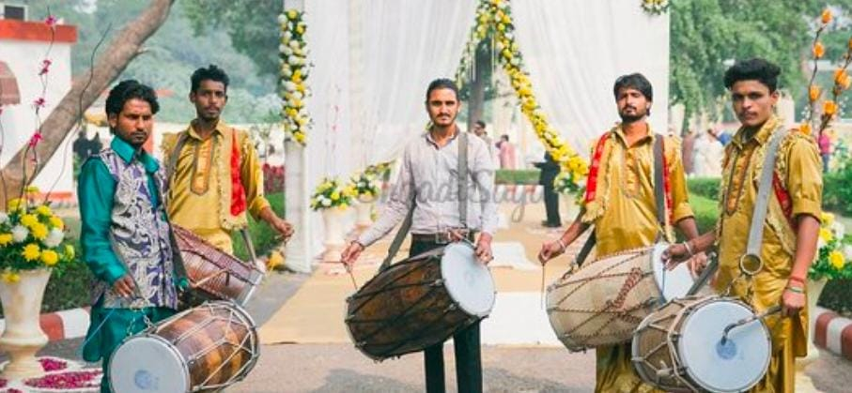
ENTERTINMENT OF WELCOMING THE GUESTS
SITAR PLAYING PERFORMANCE
ENTRY WITH ELEPHANT
WELCOME GIRLS
DHOL & NAGADA PERFORMANCE
FOLK PERFORMANCE

Slide 15
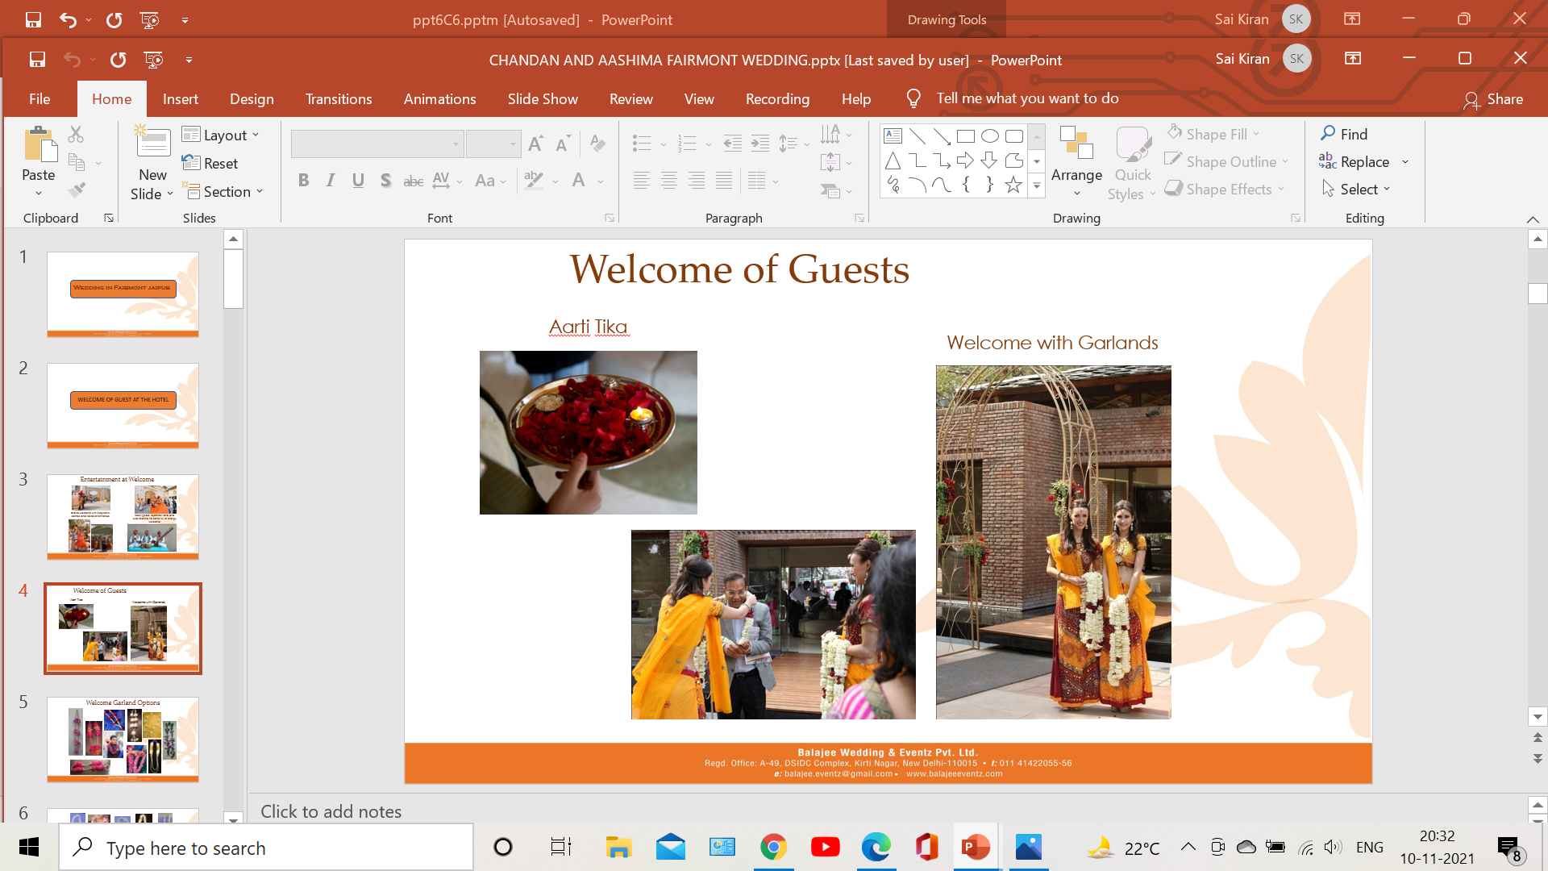
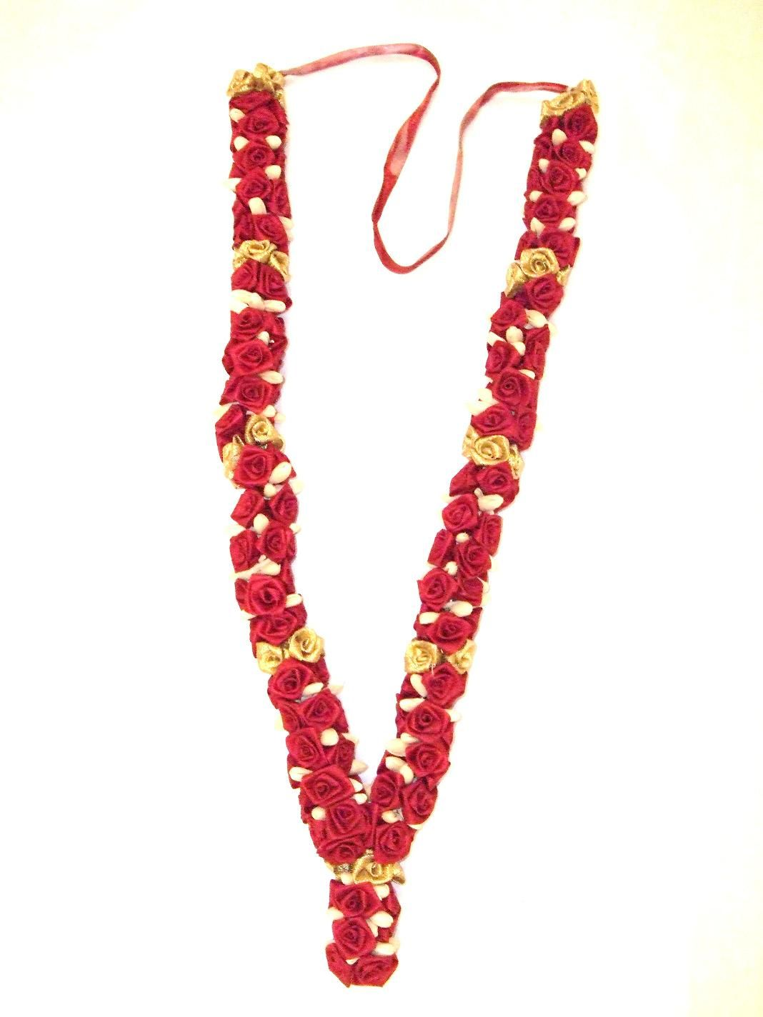
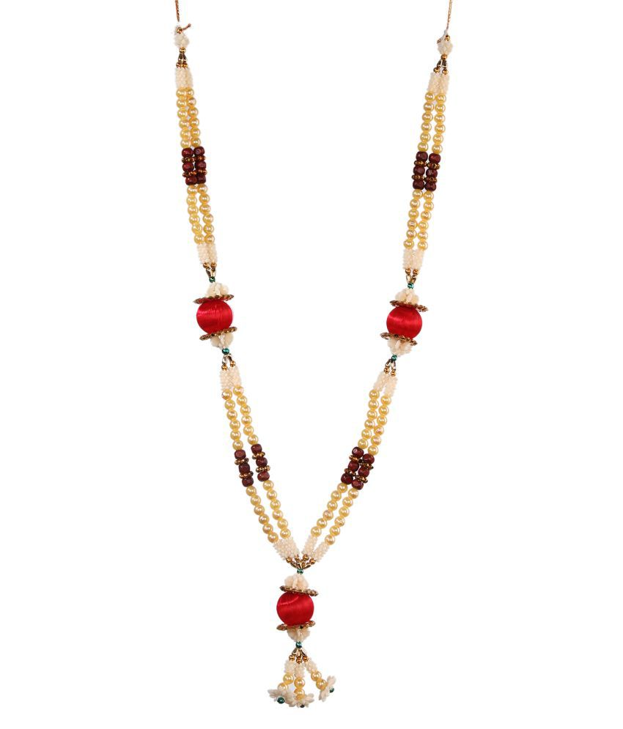
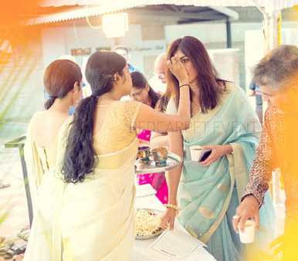
GARLANDS
AARTI & TIKKA

Slide 16
MEHNDI LUNCH (CARNIVAL THEME)

Slide 17
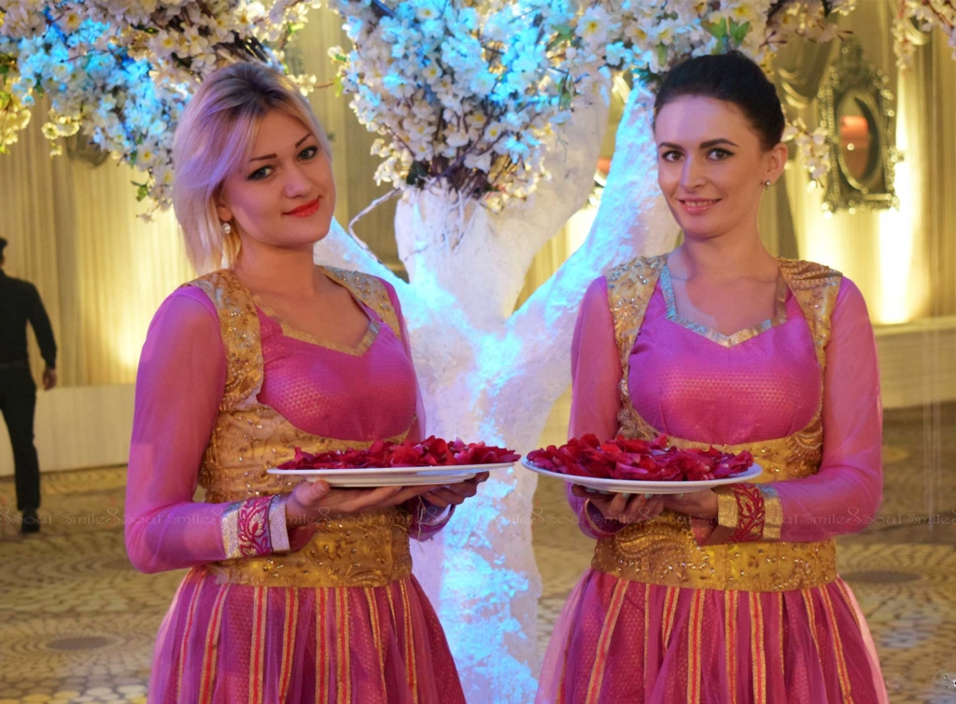
WELCOME GIRLS

Slide 18
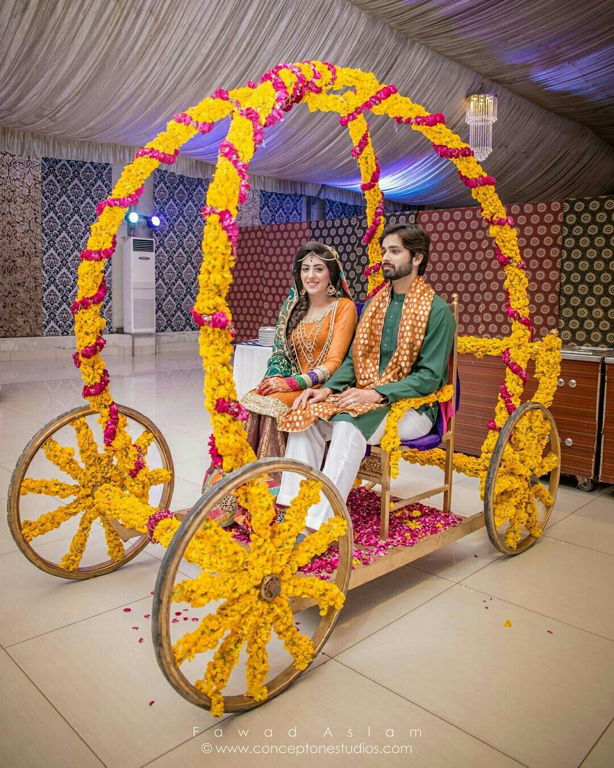
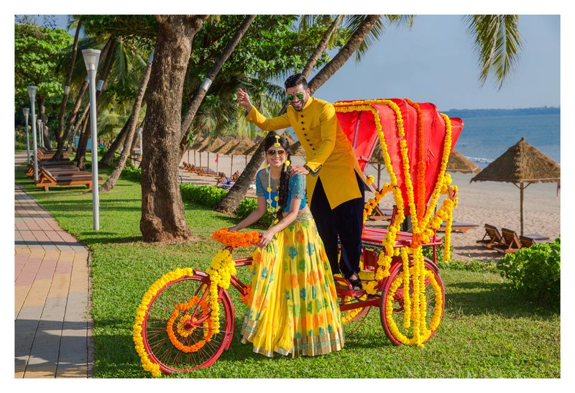
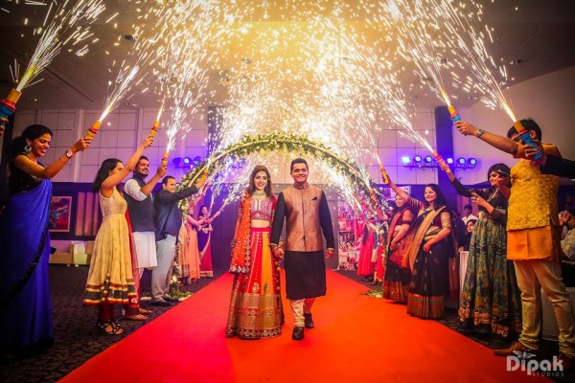
BRIDE & GROOM ENTRY IN MEHNDI

Slide 19
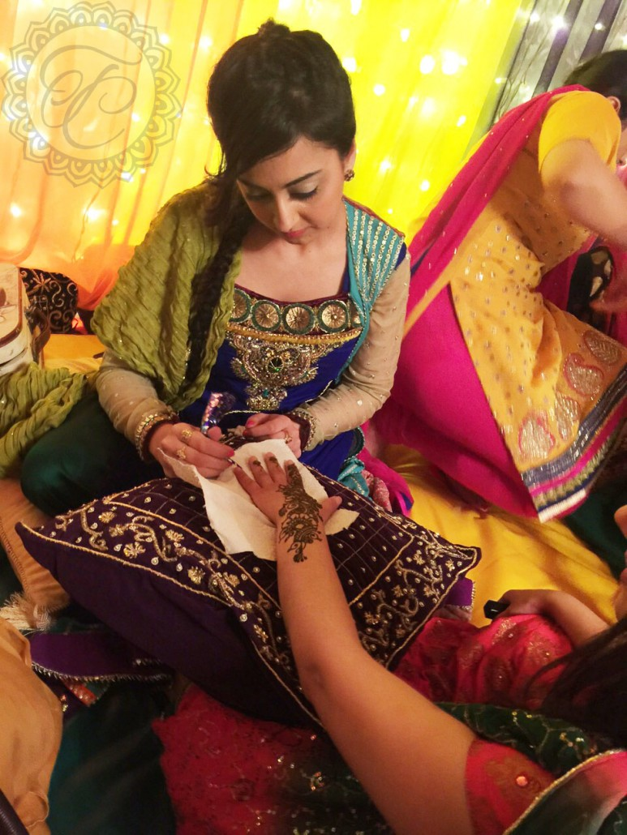
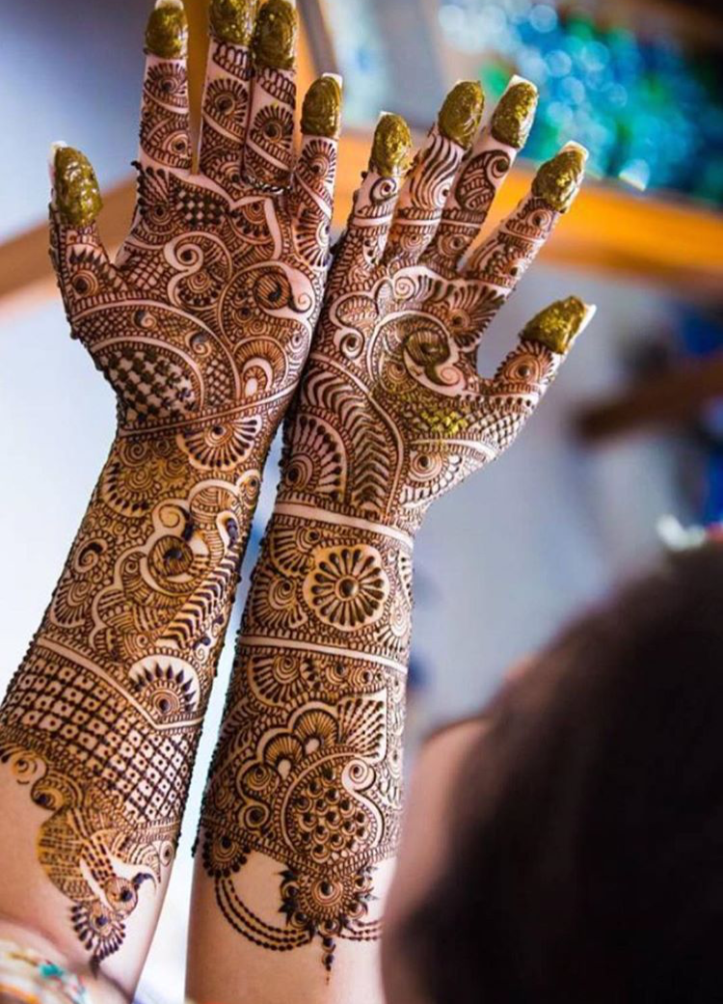
MEHNDI ARTIST

Slide 20
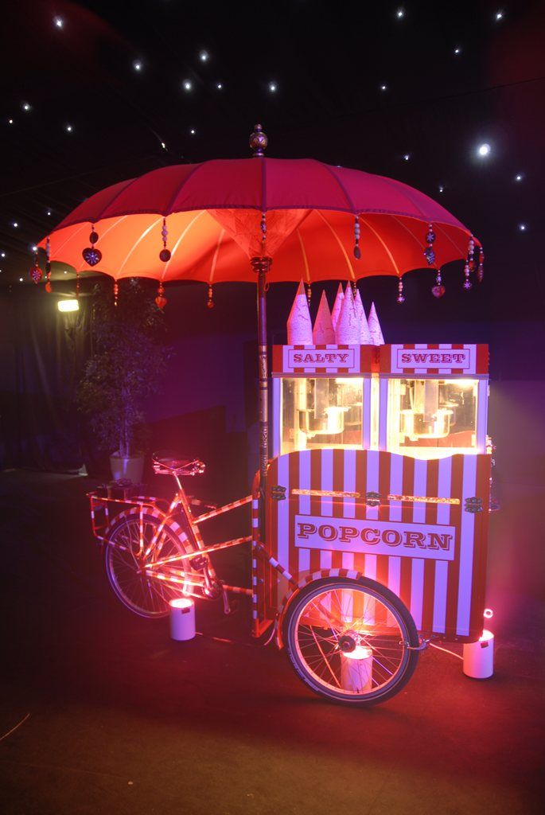
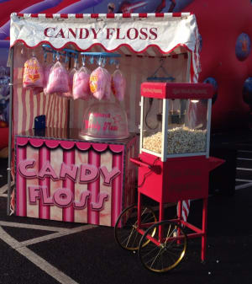
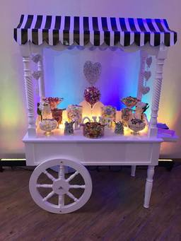
FUN FOOD STALLS
POPCORN STALL
CANDY FLOSS STALL
BHEL PUIRI STALL

Slide 21
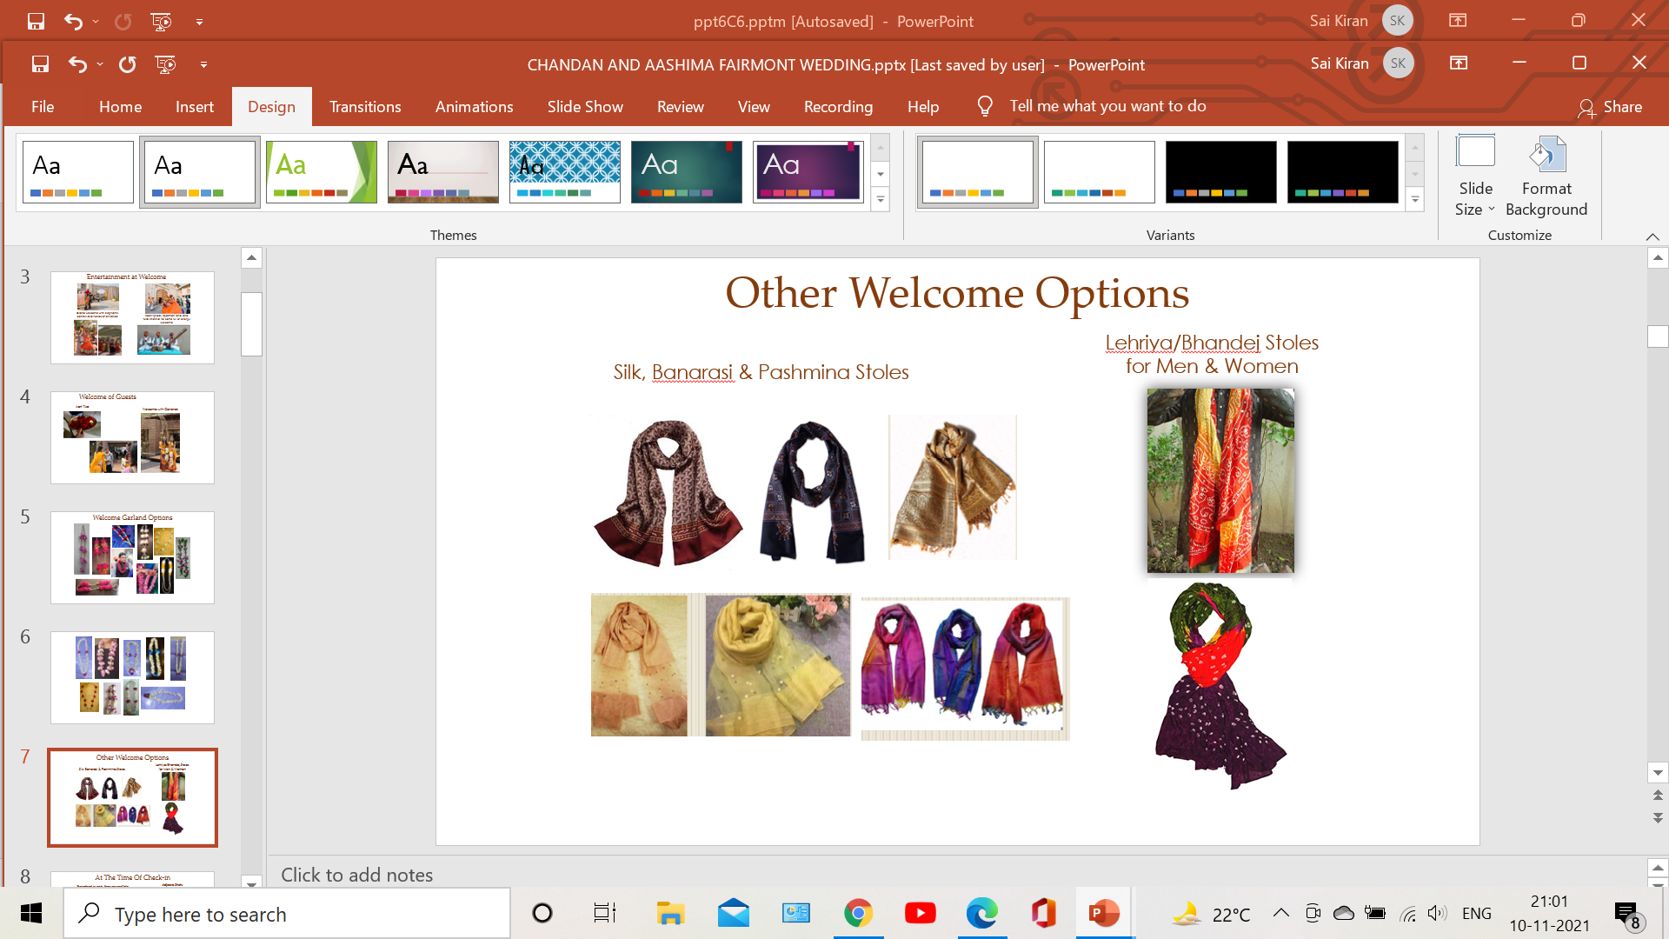

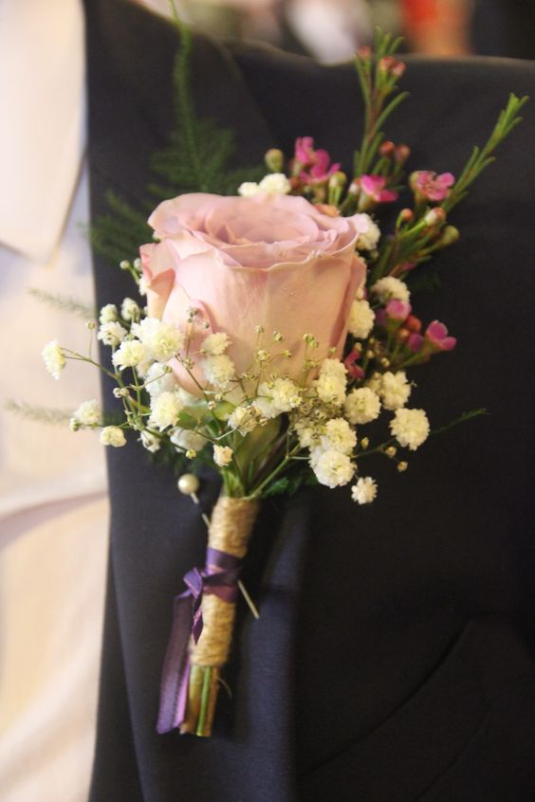
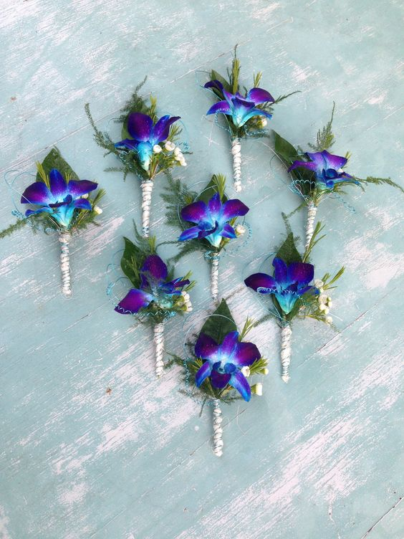
MEHNDI GIVE AWAY FOR MENS
SILK, BANARASI & PASHMINA STOLES
BROACHES FOR MEN

Slide 22
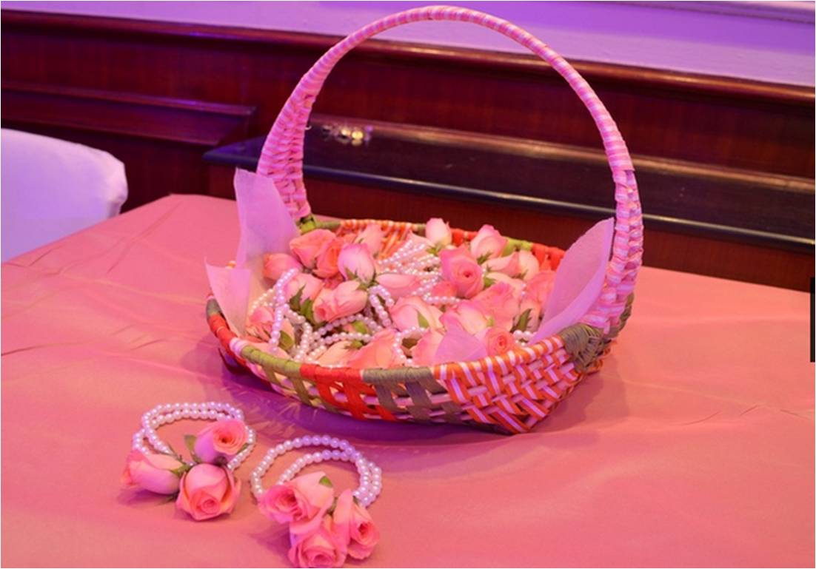
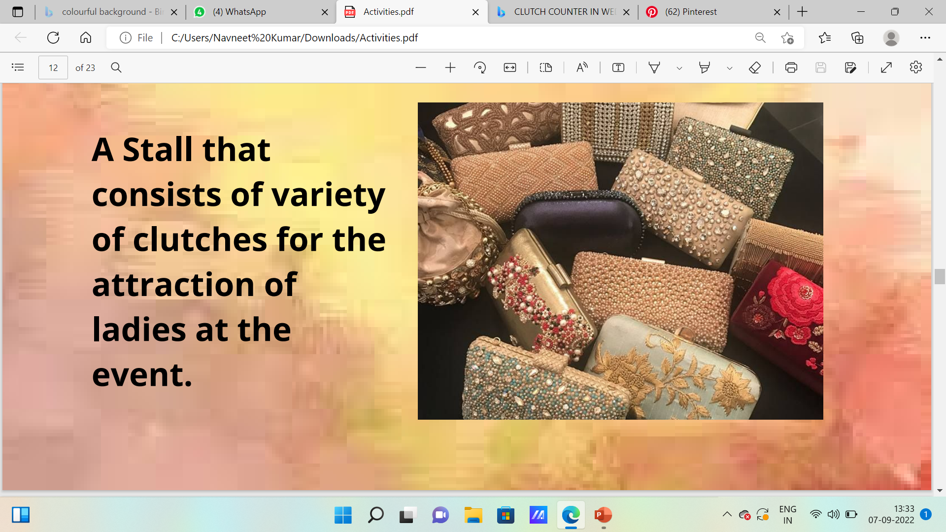
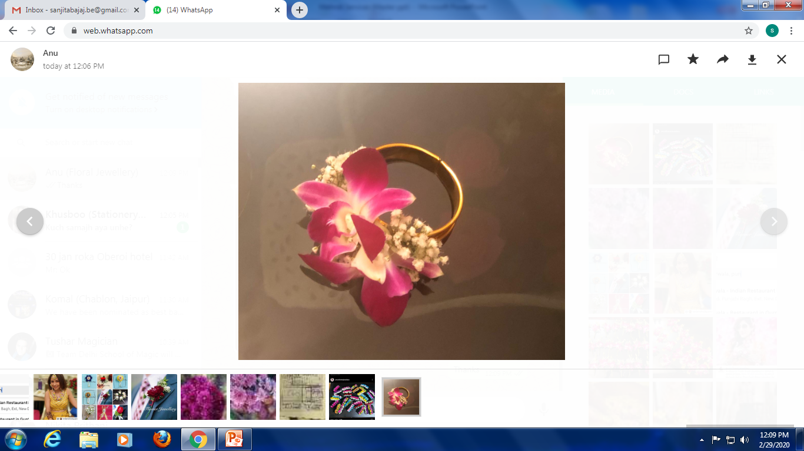
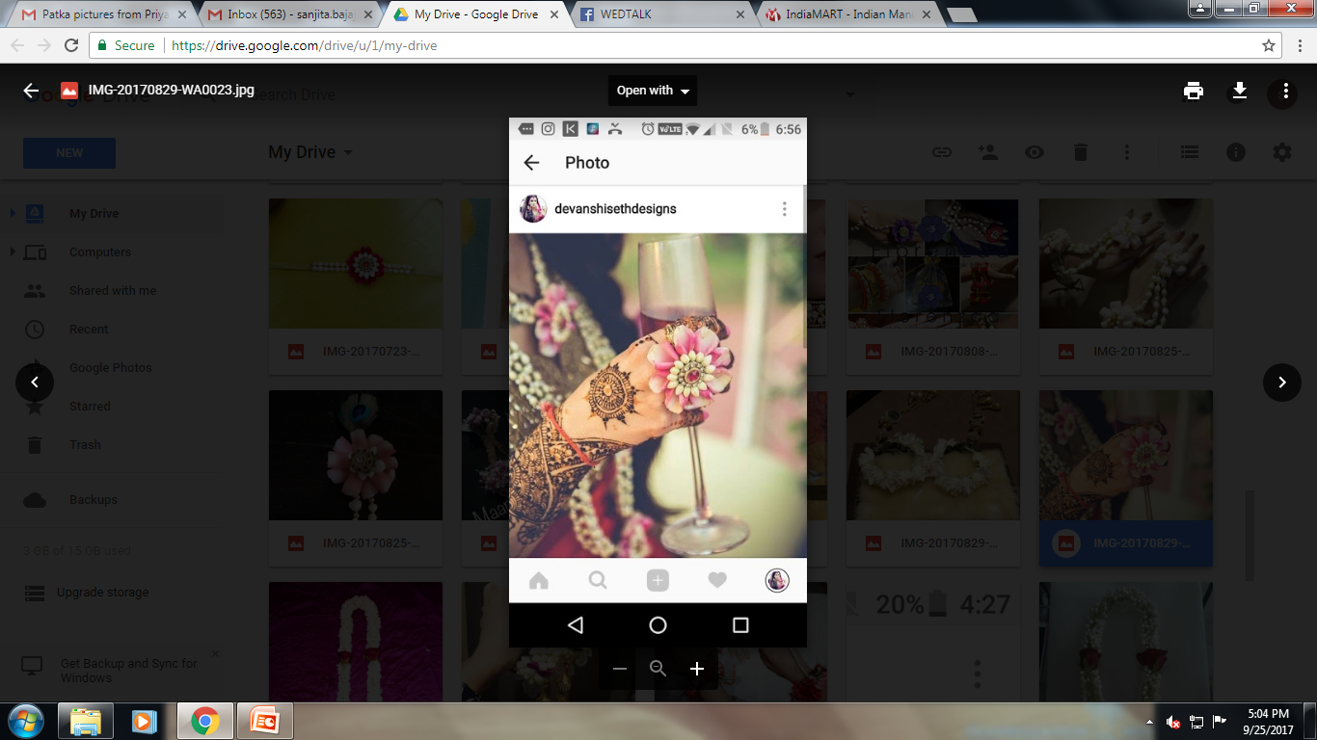
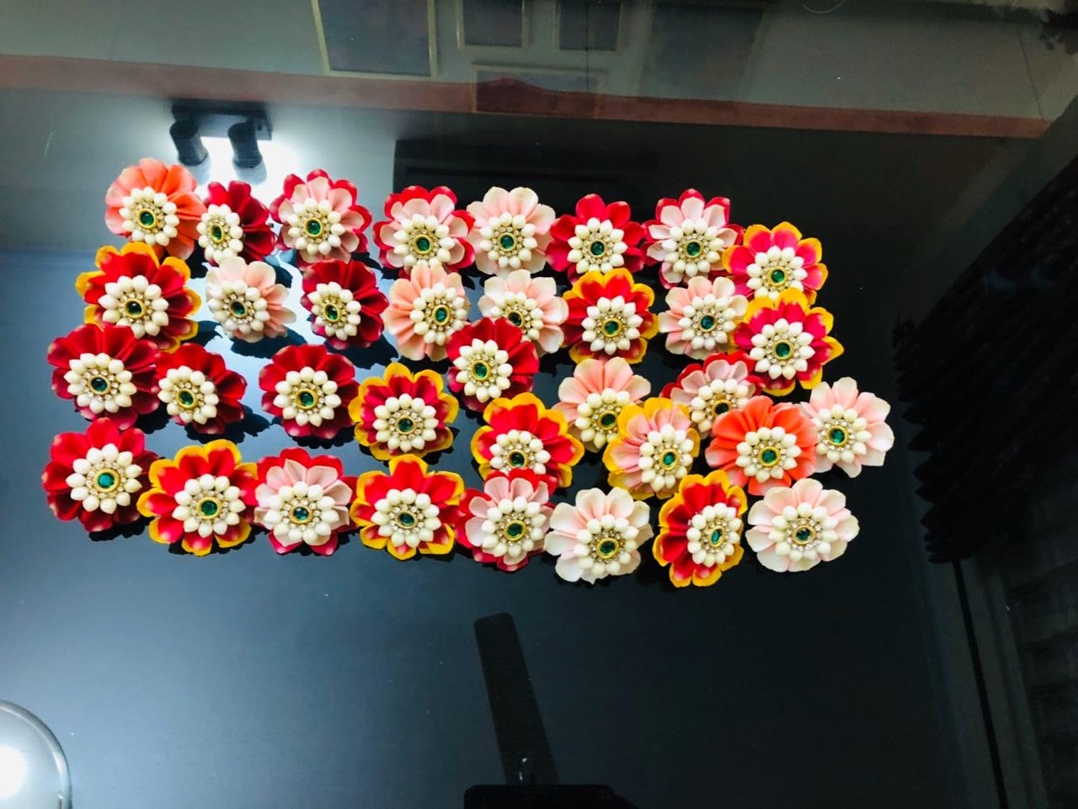
MEHNDI GIVE AWAY FOR WOMENS

Slide 23
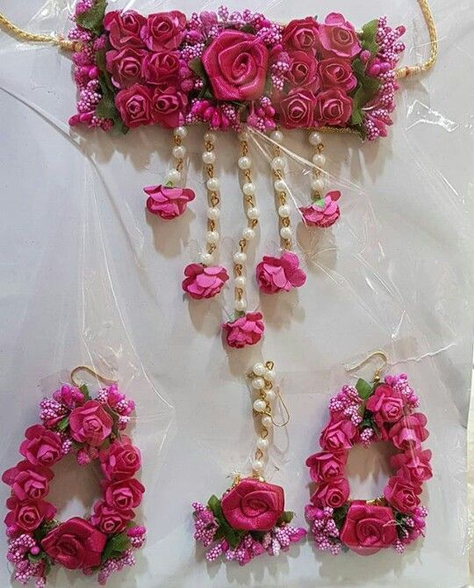
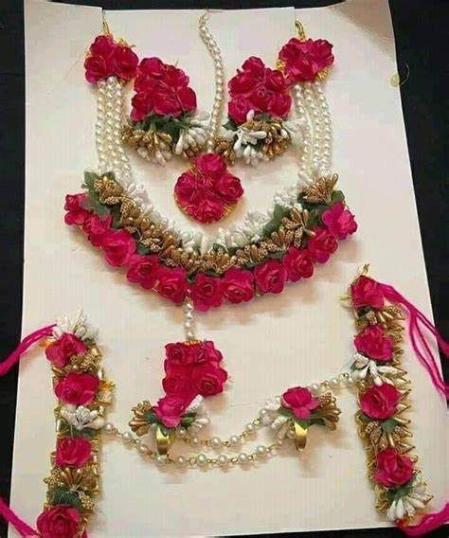
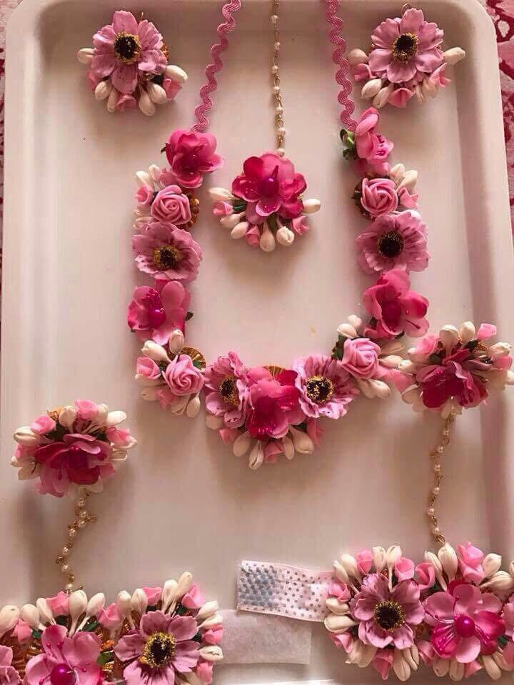
REAL FLOWER JEWELLERY FOR BRIDE

Slide 24
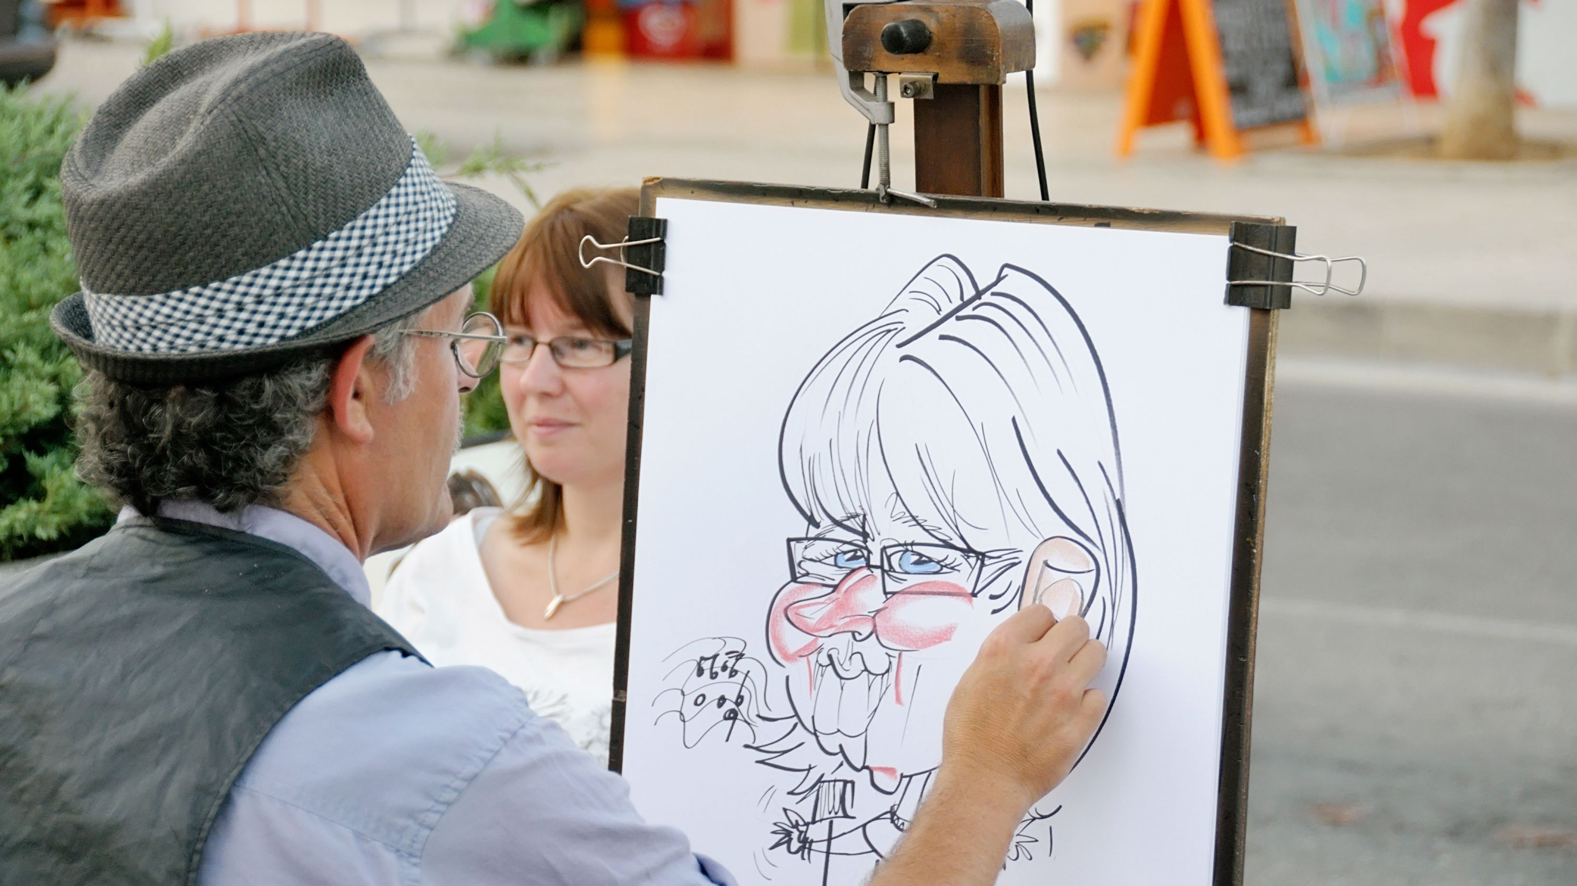
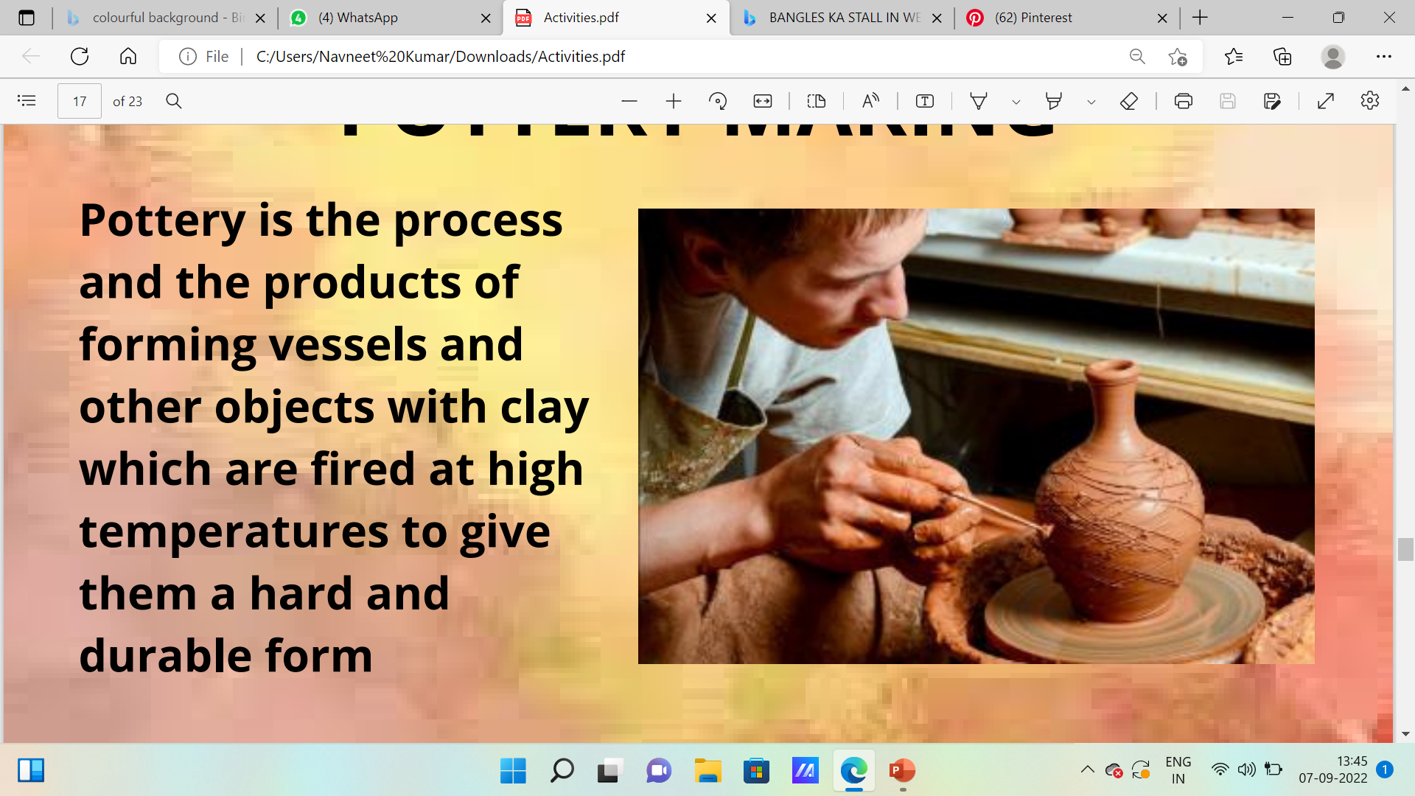
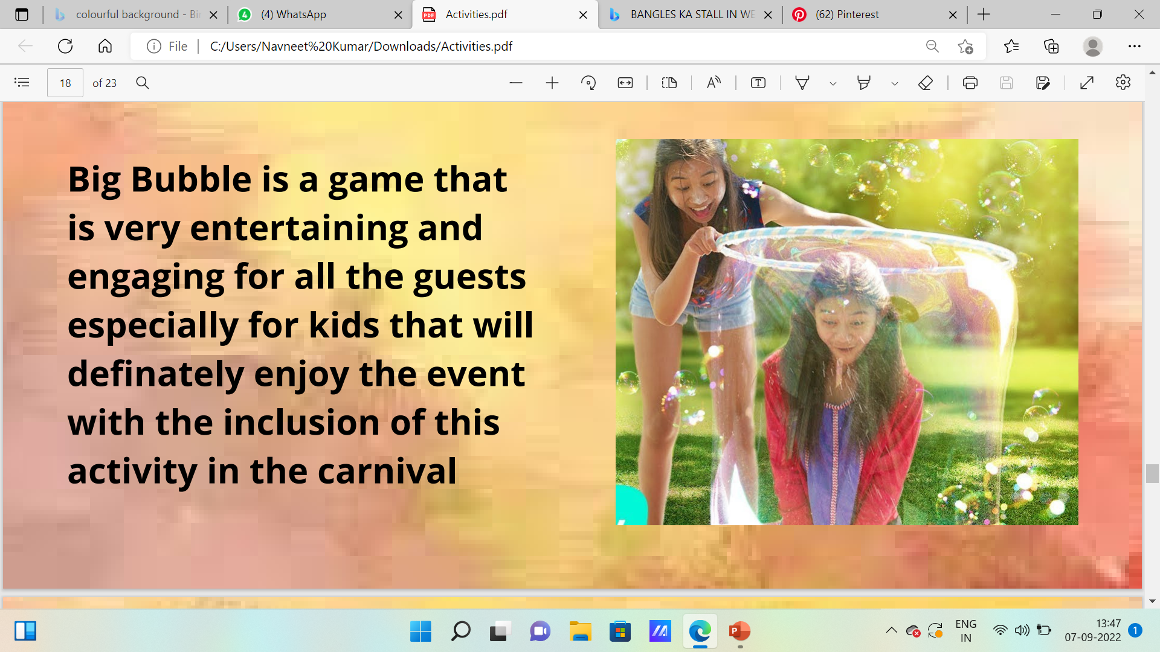
CARNIVAL FUNCTION ACTIVITIES
CARICATURE ARTIST
POTTERY MAKING
BIG BUBBLE

Slide 25





RANGOLI MAKING
NAIL ART
LAAKH KI CHUDDIYON KA STALL
FOOT MASSAGE
RING TOSS

Slide 26



MEHNDI SINGERS ARTISTS
ALISHA ARORA
ALISHA ARORA
SANCHITA HAZARE
SD LIVE SINGERS

Slide 27
SANGEET FUNCTION

Slide 28
GUESTS WELCOME
WELCOME GIRLS

Slide 29


POCKET SQUARE CUSTOMIZED GIVE AWAY FOR MENS

Slide 30



ANCHORS
UPASNA
HARNEET
EKTA

Slide 31


BRIDE & GROOM ENTRY WITH SPECIAL EFFECTS

Slide 32

CAKE CUTTING

Slide 33



SUFI ENTERTAINMNET STAGE ACTS

Slide 34




BISMIL BAND
NIZAMI BANDHU
TARKASH BAND
THE PROJECT RAAG

Slide 35



KUTLE KHAN
AKHTAR BROTHERS
NASHA BAND BY ANKHIL SACHDEVA

Slide 36


FEMALE SINGERS

Slide 37


DANCE PERFORMANCES

Slide 38


BHANGDA DANCE TROOP

Slide 39





ARTIST PERFORMANCES
SULABH NAGPAL
PRAKRITI SUKRITI
NAVRAJ HANS
SURYAVEER
BPRAAK

Slide 40






DJ ARTIST PERFORMANCES
DJ ISHY
DJ SIDDHARTH
DJ AJAY NAUTIYAL
DJ KILLOGRAM
DJ SHADOW
DJ SUMIT SETHI

Slide 41

SHOE GAME

Slide 42


GAMES FOR GUESTS
GUESS YOUR PARTNER GAME
SPIN THE WHEEL GAME

Slide 43


MOLECULAR BARS

Slide 44
HALDI FUNCTION

Slide 45
GUESTS WELCOME
WELCOME GIRLS

Slide 46

COLOURFUL SMOKE PYRO ENTRY

Slide 47

CHANA JOR GARAM
PUPPET SHOW

Slide 48



POTALI / PURSES
JUTTI STALL
JEWELLERY COUNTER

Slide 49

TUG OF WAR GAME

Slide 50
SHIKANJI WALE
GOLA WALA STALL

Slide 51





ACTIVITIES FOR GUESTS
FOOLON KI HOLI
WHEEL OF FUN COMPETITION
RAIN DANCE
GOL GAPPA COMPETITION
KITE FLYING COMPETITION

Slide 52


A DANCE BOWL
BEER PONG GAME

Slide 53
SEHRABANDI

Slide 54

PAGDI FOR BARATIES

Slide 55
BARAAT

Slide 56




BAGGI WITH 4 HORSES
CAMEL RIDES
ELEPHANT RIDES
LANCER HORSES
PROPS

Slide 57




VINTAGE CARS
DJ TROLLA
SPECIAL EFFECTS
MOVING BARS

Slide 58




BRIDE ENTRY

Slide 59


GROOM ENTRY

Slide 60


